Slide 1
Heat and the Cosmic Microwave Background

Slide 2
In this Smart Lesson you will do the following:
Describe what Cosmic Microwave Background is.
Compare the theories about the creation of the universe.
Discuss how Cosmic Microwave Background supports this theory.

Slide 3
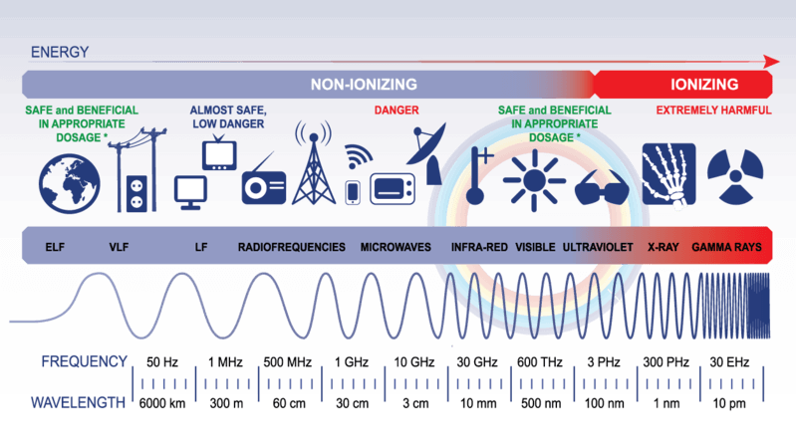
Our universe is filled with electromagnetic radiation.
This electromagnetic radiation exists as waves that ranges from radio waves, visible light and all the way up to gamma radiation.
These waves can be transmitted through a vacuum such as space.

Slide 4
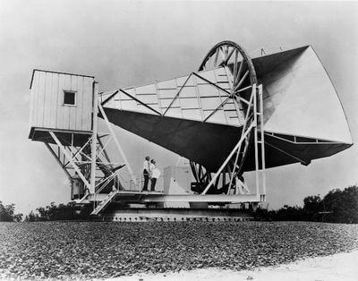
The Cosmic Microwave Background, or the CMB for short, is electromagnetic radiation that fills the universe, and can be detected in every direction we look.
We cannot see the CMB, as it has a wavelength undetectable to our eyes, but we can detect it using instruments such as the radio receiver shown below:

Slide 5
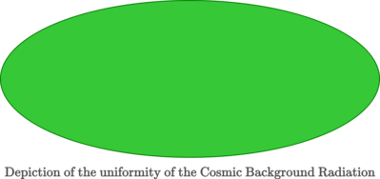
However, if we could see the CMB, then the entire sky would glow with an astonishing uniform brightness in every direction.
The picture below depicts what we would observe if we could see the CMB temperature brightness over the full sky:
The temperature is so uniform it all looks like a single shade of green!

Slide 6
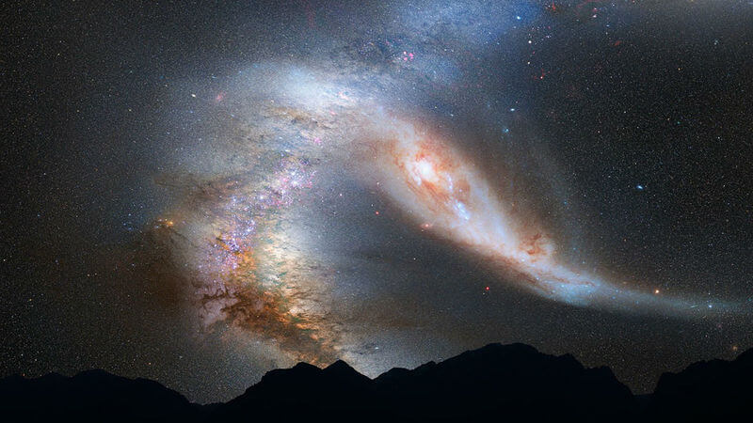
So what exactly is the CMB and why does it exist?
To answer those questions we need to start with the Big Bang.
If we look out into deep space, we are able to look back in time, at the origins of the universe.

Slide 7
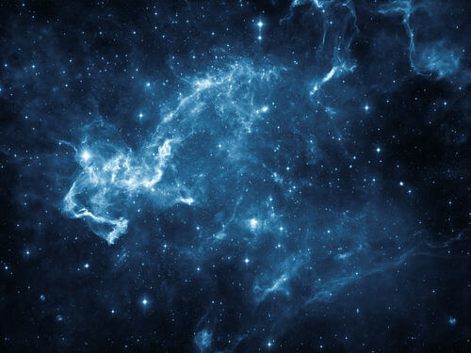
The Big Bang theory is the prevailing model for how the universe began.
It describes that the entire universe was in a state that was both extremely dense and hot.
This single state then expanded resulting in the creation of simple matter, such as protons, electrons and atoms like hydrogen and helium, and the emission of electromagnetic waves. As the universe began to expand it also began to cool.
This eventually lead to the universe as we know it today as well the CMB.

Slide 8
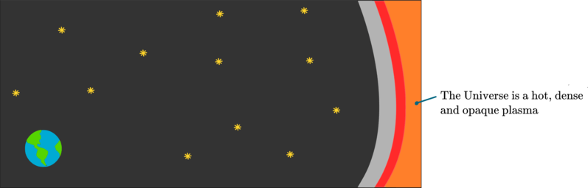
Before the formation of the CMB, the universe was a hot, dense and opaque plasma that contained both matter and energy.
No light escaped from this plasma, as photons could not travel freely.

Slide 9
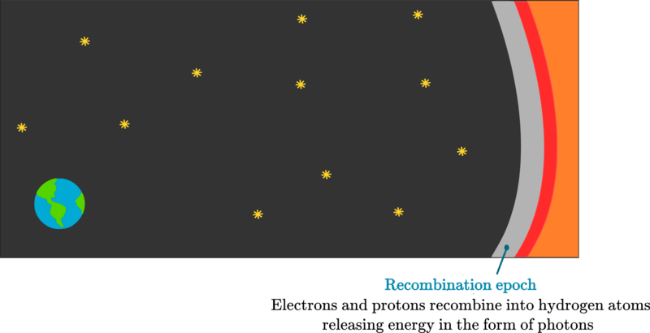
This hot, dense and opaque universe began to cool.
As the universe started to cool, to a temperature of around 2700ºC, electrons and protons started to recombine into hydrogen atoms. In doing so they released energy in the form of photons, which we now call the CMB.
This recombination is why this period of time is known as the Recombination epoch.

Slide 10
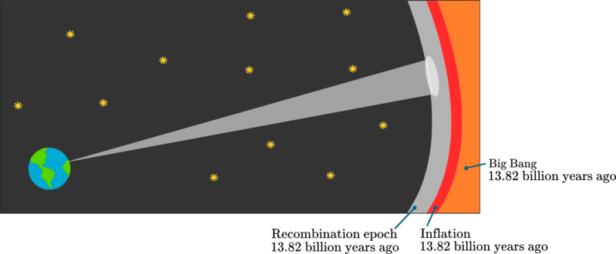
Astronomers can see the CMB when they look out into deep space.
They see that the formation of the CMB began around 378000 years after the Big Bang, with the Big Bang occurring 13.82 billion years ago.
The time during which the CMB formed is known as the Recombination epoch.

Slide 11
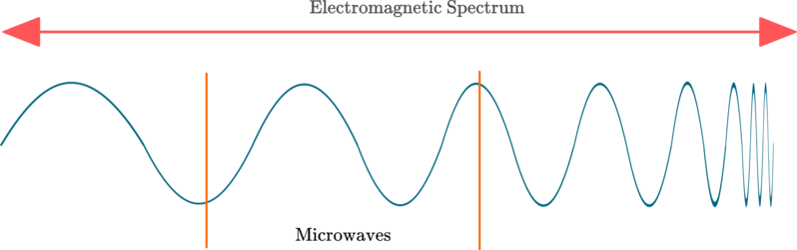
So where is the CMB currently?
Currently the CMB is at a very cold temperature of only 2.725ºC above absolute zero - absolute zero is the temperature (−273.15ºC) at which atoms stop moving.
This is because over time, the temperature of the universe has cooled as it has expanded.
The extremely cold temperatures is what causes the CMB to fall in the microwave portion of the electromagnetic spectrum.

Slide 12
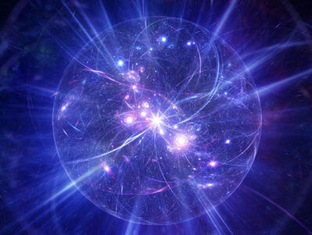
So how was the CMB discovered, if we are not able to directly see microwave radiation?
Well, the CMB was first predicted by Ralph Alpher in 1948, in line with his research on the Big Bang.

Slide 13
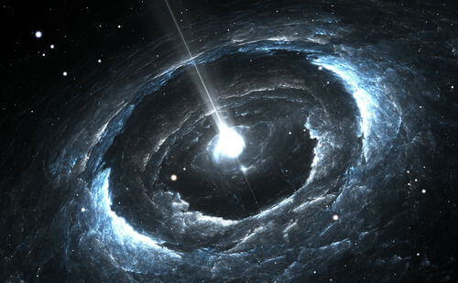
Ralph Adler proposed that there if the Big Bang occurred there must be some kind of thermal remnant.
This radiation is a remnant of when the universe cooled down enough to form neutral elements, becoming transparent, that couldn't absorb certain wavelengths of electromagnetic radiation.

Slide 14
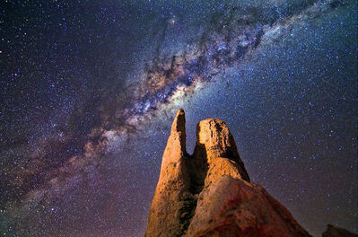
The CMB was then detected by accident in 1963 by Arno Penzias and Robert Wilson.
Arno Penzias and Robert Wilson were studying microwave signals from the Milky Way with a radio receiver they were building.
They detected a noise, which at first they thought was interference from pigeon droppings. However, they soon came to realise that they were in fact detecting the CMB, due to the uniformity of the signal.

Slide 15
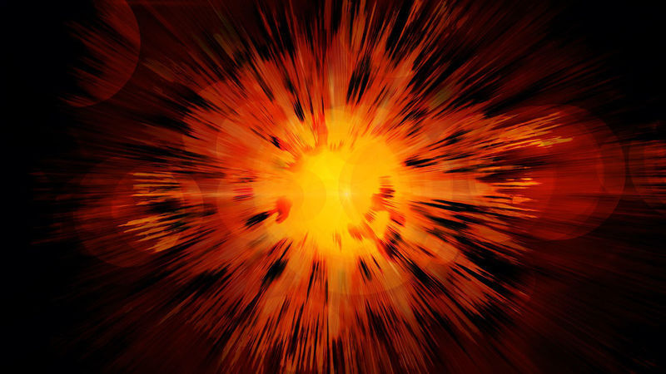
How is the CMB evidence for the existence of the Big Bang?
Let's have a look at some of the support that the CMB gives to the Big Bang theory.

Slide 16
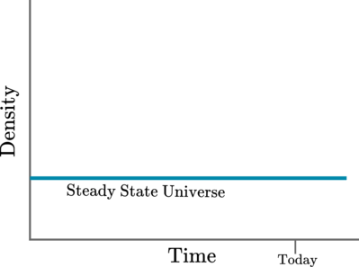
When scientists were hypothesising how the universe started, there were 2 competing theories.
There was the Steady State theory, which predicted that matter is continuously created as the universe expands, and the universe has been around forever.

Slide 17
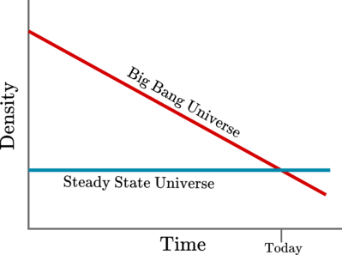
There was also the Big Bang theory.
This predicted that the expanding universe must have been denser in the past and therefore must have had infinite density at the start.

Slide 18
The Big Bang theory predicts that the CMB will be highly uniform in all directions.
This is because after the Big Bang, the universe expanded at an equal rate in every direction from the infinitely dense point that it started from.
What we do find is that the CMB is highly uniform in all directions. No matter which part of the universe we look at, the CMB has a highly uniform temperature, only varying by less than 0.0001 degrees.

Slide 19

It was also predicted that as the universe expanded, this would then stretch and thus cool.
This cooling of high temperature radiation of the early universe resulted in microwave radiation.
This prediction turned out to be accurate. The CMB is microwave radiation which has a very low temperature of 2.725ºC above absolute zero (−273.15ºC).

Slide 20

Therefore, both the low temperature and the uniformity of the CMB provide evidence for the Big Bang theory, as opposed to the Steady State theory.

